Slide 1
CNN Model Architectures -II
Lecture 5
Part 2
Generative AI for Computer Vision

Slide 2
Content
Dense Net
Mobile Net
Efficient Net

Slide 3
Content
Dense Net
Mobile Net
Efficient Net

Slide 4
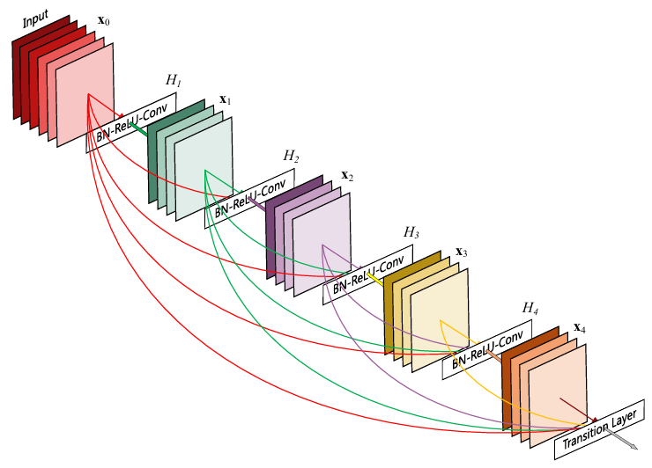
Dense-Net
Dense-Net (Densely Connected Convolutional Network) is a convolutional neural network architecture that introduces direct connections between every layer and all subsequent layers within a dense block.
Unlike traditional CNNs, where each layer receives input only from the previous layer, Dense-Net concatenates the feature maps from all preceding layers and uses them as input for the current layer.
This dense connectivity improves feature reuse, strengthens gradient flow, and alleviates the vanishing gradient problem, enabling the training of very deep networks with fewer parameters.
A 5-layer dense block with a growth rate of k = 4. Each layer takes all preceding feature-maps as input.
Image Source: Gao Huang; Zhuang Liu; Laurens Van Der Maaten; Kilian Q. Weinberger, “Densely Connected Convolutional Networks”, CVPR 2017

Slide 5
Dense-Net
A Dense-Net architecture typically consists of an initial convolution layer, multiple dense blocks separated by transition layers, and a final classification layer.
Each dense block contains several convolutional layers, while transition layers include batch normalization, a 1×1 convolution, and average pooling to reduce the number of feature maps and spatial dimensions.
By encouraging feature propagation and minimizing redundant learning, Dense-Net achieves high classification accuracy with improved computational efficiency, making it well suited for image classification, object detection, and medical image analysis tasks.
A 5-layer dense block with a growth rate of k = 4. Each layer takes all preceding feature-maps as input.
Image Source: Gao Huang; Zhuang Liu; Laurens Van Der Maaten; Kilian Q. Weinberger, “Densely Connected Convolutional Networks”, CVPR 2017

Slide 6

Dense-Net
In a conventional Convolutional Neural Network (CNN), an architecture with L layers typically contains L direct connections, where each layer receives input only from the immediately preceding layer and passes its output to the next.
For example, a traditional 6-layer CNN would have only six sequential connections represented by the straight arrows between adjacent layers.
In contrast, DenseNet introduces dense connectivity, where each layer receives feature maps from all preceding layers and forwards its own feature maps to all subsequent layers.
Classifier
Plain CNN
Classifier
Res Net
Classifier
6(6 + 1)/2 = 21
Dense Net
6+5+4+3+2+1=21 (Total Connections)

Slide 7
Dense-Net
As a result, an L-layer DenseNet contains L(L + 1)/2 direct connections.
Therefore, for a network with six layers, the total number of connections becomes 6(6 + 1)/2 = 21.
This dense connectivity promotes feature reuse, strengthens gradient propagation, alleviates the vanishing gradient problem, and improves parameter efficiency by allowing later layers to access features learned throughout the network.
Classifier
Plain CNN
Classifier
Res Net
Classifier
6(6 + 1)/2 = 21
Dense Net
6+5+4+3+2+1=21 (Total Connections)

Slide 8
Content
Dense Net
Mobile Net
Efficient Net

Slide 9
Mobile Net
Mobile Net is a lightweight convolutional neural network (CNN) architecture designed for efficient image classification and computer vision tasks on resource-constrained devices such as smartphones, embedded systems, and IoT devices.
The Mobile Net architecture is built upon depth-wise separable convolutions, a factorized convolution technique that significantly reduces computational complexity and model size compared to standard convolutions.
Instead of performing spatial filtering and channel combination in a single operation, Mobile Net decomposes the standard convolution into two sequential layers: a depth-wise convolution followed by a pointwise convolution.
This factorization significantly reduces the number of parameters and floating-point operations (FLOPs) while maintaining competitive accuracy.
Andrew G. Howard et. al., “MobileNets: Efficient Convolutional Neural Networks for Mobile Vision Applications”, https://doi.org/10.48550/arXiv.1704.04861

Slide 10
Depth-wise separable convolutions
Depth-wise separable convolutions is a form of factorized convolutions which factorize a standard convolution into a depth-wise convolution and a 1×1convolution called a pointwise convolution.
The depth-wise convolution applies a single convolutional filter independently to each input channel, enabling efficient spatial feature extraction without mixing channel information.
Subsequently, the pointwise convolution, implemented as a (1x1) convolution, combines the outputs across all channels to generate a new set of feature maps.
Andrew G. Howard et. al., “MobileNets: Efficient Convolutional Neural Networks for Mobile Vision Applications”, https://doi.org/10.48550/arXiv.1704.04861

Slide 11
Depth-wise convolution
Depth-wise convolution is a convolution operation in which a single convolutional filter is applied independently to each input channel of a feature map. Unlike a standard convolution, which simultaneously performs spatial filtering and combines information across all input channels, depth-wise convolution processes each channel separately without inter-channel mixing.
If the input has (K) channels, depth-wise convolution employs (K) distinct filters, each operating on one corresponding channel to extract spatial features. This operation significantly reduces the number of parameters and computational cost because it eliminates the need to convolve across all input channels.
Depth-wise convolution
…
p
p
p
M
R
q
1
q
1
q
1
K
K
N
1
2
K
S
Andrew G. Howard et. al., “MobileNets: Efficient Convolutional Neural Networks for Mobile Vision Applications”, https://doi.org/10.48550/arXiv.1704.04861

Slide 12
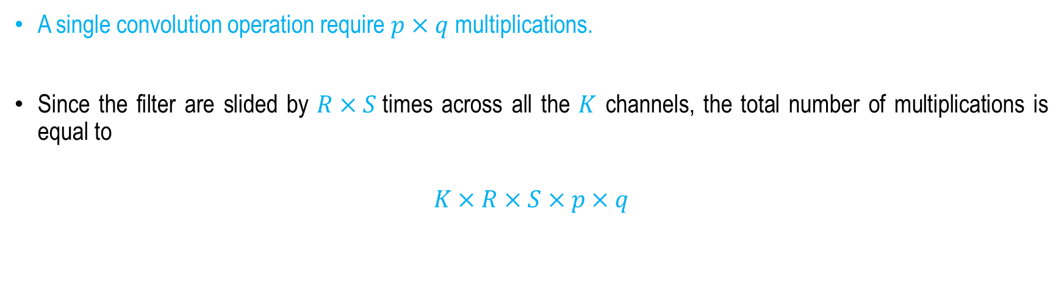
Depth-wise convolution
A single convolution operation require $p×q$multiplications.
Since the filter are slided by $R×S$times across all the $K$ channels, the total number of multiplications is equal to
$$K×R×S×p×q$$
Depth-wise convolution
…
p
p
p
M
R
q
1
q
1
q
1
K
K
N
1
2
K
S
Andrew G. Howard et. al., “MobileNets: Efficient Convolutional Neural Networks for Mobile Vision Applications”, https://doi.org/10.48550/arXiv.1704.04861

Slide 13

Pointwise convolution
However, since depth-wise convolution does not combine information between channels, it is typically followed by a pointwise convolution (a $1×1$ convolution), which integrates the channel-wise features into a new set of output feature maps.
So for point wise convolution operation, Total no of multiplications = $K×M×N×L$
Pointwise convolution
M
…
M
1
K
1
K
1
K
K
L
N
1
1
1
N
1
2
L
Andrew G. Howard et. al., “MobileNets: Efficient Convolutional Neural Networks for Mobile Vision Applications”, https://doi.org/10.48550/arXiv.1704.04861

Slide 14

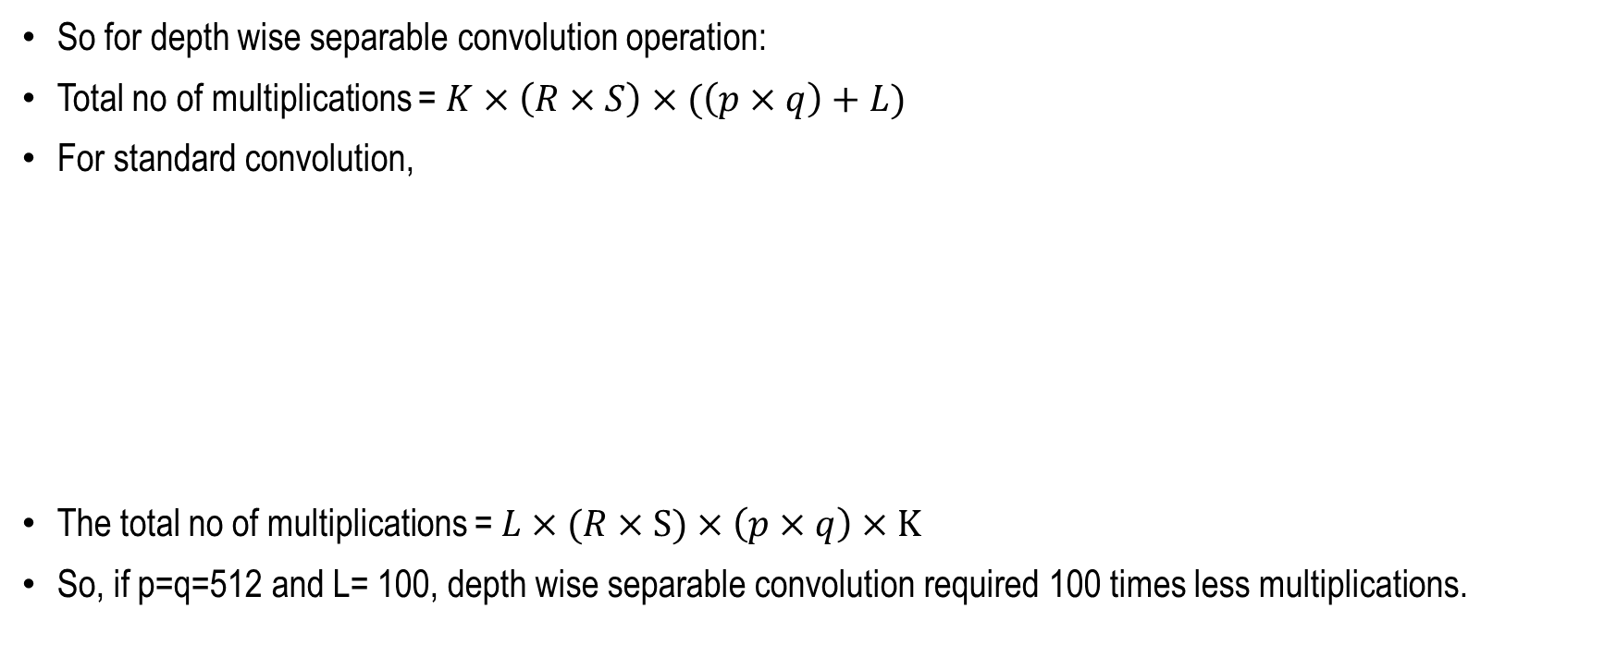
Depth-wise separable convolutions
So for depth wise separable convolution operation:
Total no of multiplications = $K×\left(R×S\right)×(\left(p×q\right)+L)$
For standard convolution,
The total no of multiplications = $L×(R×S)×\left(p×q\right)×K$
So, if p=q=512 and L= 100, depth wise separable convolution required 100 times less multiplications.
$$×$$
p
R
M
L
L
q
S
K
N
Andrew G. Howard et. al., “MobileNets: Efficient Convolutional Neural Networks for Mobile Vision Applications”, https://doi.org/10.48550/arXiv.1704.04861

Slide 15
Mobile Net
A standard convolution simultaneously performs both spatial filtering and channel-wise feature aggregation in a single operation, resulting in substantially higher computational cost.
By separating these processes, depth-wise separable convolutions substantially reduce the number of parameters and floating-point operations (FLOPs) while preserving strong feature representation capability.
This computational efficiency makes Mobile Net particularly well suited for deployment on resource-constrained devices, such as smartphones, embedded systems, and Internet of Things (IoT) applications, where low latency and limited memory are critical requirements.
Subsequent versions, including MobileNetV2 and MobileNetV3, further enhance performance through innovations such as inverted residual blocks, linear bottlenecks, squeeze-and-excitation modules, and neural architecture search, making the MobileNet family well suited for real-time applications requiring high accuracy with low latency and minimal memory consumption.
Andrew G. Howard et. al., “MobileNets: Efficient Convolutional Neural Networks for Mobile Vision Applications”, https://doi.org/10.48550/arXiv.1704.04861

Slide 16
Content
Dense Net
Mobile Net
Efficient Net

Slide 17
Efficient Net
Efficient Net is a family of convolutional neural network (CNN) architectures that achieves high classification accuracy with significantly fewer parameters and lower computational cost through a compound scaling strategy.
Unlike conventional approaches that arbitrarily scale network depth, width, or input image resolution independently, Efficient Net uniformly scales all three dimensions using a fixed set of scaling coefficients.
The baseline model, EfficientNet-B0, is designed through neural architecture search (NAS) and employs mobile inverted bottleneck convolution (MBConv) blocks, which incorporate depth-wise separable convolutions, inverted residual connections, linear bottlenecks, and squeeze-and-excitation (SE) attention modules to enhance feature representation while maintaining computational efficiency.
Mingxing Tan, Quoc V. Le, EfficientNet: Rethinking Model Scaling for Convolutional Neural Networks, https://doi.org/10.48550/arXiv.1905.11946

Slide 18
Efficient Net
Higher variants, ranging from EfficientNet-B1 to EfficientNet-B7, are generated by systematically applying the compound scaling method, resulting in improved accuracy without a proportional increase in computational complexity.
The architecture also utilizes batch normalization, the Swish (SiLU) activation function, and residual connections to facilitate efficient gradient propagation and stable training.
Owing to its balanced scaling strategy and optimized building blocks, Efficient Net provides an excellent trade-off between accuracy, model size, and inference speed, making it well suited for image classification, object detection, and transfer learning applications, particularly in environments with limited computational resources.
Mingxing Tan, Quoc V. Le, EfficientNet: Rethinking Model Scaling for Convolutional Neural Networks, https://doi.org/10.48550/arXiv.1905.11946

Slide 19
Model Scaling
Convolutional Neural Networks (CNNs) can be scaled to satisfy different computational and memory constraints by increasing their network depth, network width, or input image resolution.
For example, the Res-Net family scales model capacity by varying the number of layers, while architectures such as Wide-Res-Net and Mobile Net increase representational power by expanding the number of channels in each layer.
Similarly, increasing the input image resolution enables the network to capture finer spatial details, often leading to improved classification accuracy at the expense of higher computational complexity and increased floating-point operations (FLOPs).
Mingxing Tan, Quoc V. Le, EfficientNet: Rethinking Model Scaling for Convolutional Neural Networks, https://doi.org/10.48550/arXiv.1905.11946

Slide 20
Model Scaling
Although previous studies have demonstrated that network depth and width significantly influence the representational capacity and learning ability of CNNs, these dimensions have traditionally been scaled independently, resulting in suboptimal trade-offs between accuracy and computational efficiency.
Efficient Net addresses this limitation by introducing a compound scaling strategy that systematically and uniformly scales network depth, width, and input resolution using a fixed set of scaling coefficients.
This balanced scaling approach enables the network to utilize computational resources more effectively, achieving superior accuracy while maintaining a relatively small model size and lower computational cost compared with conventional scaling methods.
Mingxing Tan, Quoc V. Le, EfficientNet: Rethinking Model Scaling for Convolutional Neural Networks, https://doi.org/10.48550/arXiv.1905.11946

Slide 21
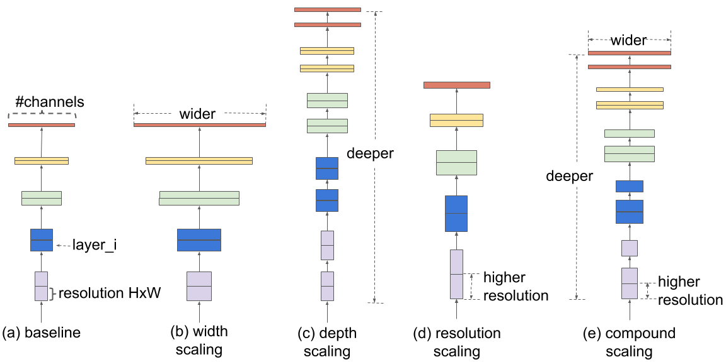
Model Scaling
Mingxing Tan, Quoc V. Le, EfficientNet: Rethinking Model Scaling for Convolutional Neural Networks, https://doi.org/10.48550/arXiv.1905.11946

Slide 22
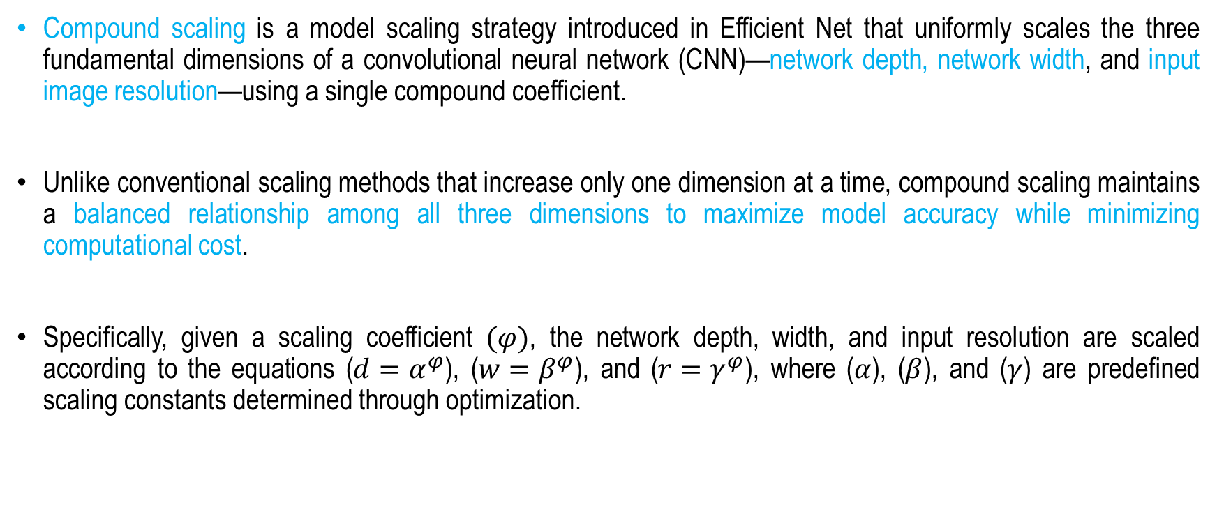
Compound scaling
Compound scaling is a model scaling strategy introduced in Efficient Net that uniformly scales the three fundamental dimensions of a convolutional neural network (CNN)—network depth, network width, and input image resolution—using a single compound coefficient.
Unlike conventional scaling methods that increase only one dimension at a time, compound scaling maintains a balanced relationship among all three dimensions to maximize model accuracy while minimizing computational cost.
Specifically, given a scaling coefficient $(φ)$, the network depth, width, and input resolution are scaled according to the equations ($d=α^{φ}$), ($w=β^{φ}$), and ($r=γ^{φ}$), where ($α$), ($β$), and ($γ$) are predefined scaling constants determined through optimization.
Mingxing Tan, Quoc V. Le, EfficientNet: Rethinking Model Scaling for Convolutional Neural Networks, https://doi.org/10.48550/arXiv.1905.11946

Slide 23
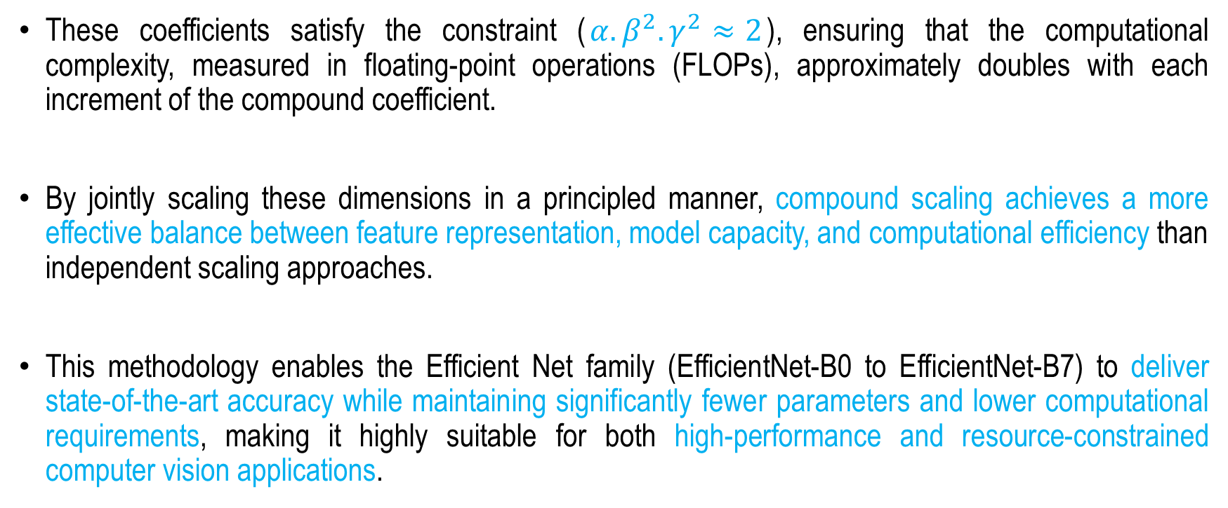
Compound scaling
These coefficients satisfy the constraint ($α.β^{2}.γ^{2}≈2$), ensuring that the computational complexity, measured in floating-point operations (FLOPs), approximately doubles with each increment of the compound coefficient.
By jointly scaling these dimensions in a principled manner, compound scaling achieves a more effective balance between feature representation, model capacity, and computational efficiency than independent scaling approaches.
This methodology enables the Efficient Net family (EfficientNet-B0 to EfficientNet-B7) to deliver state-of-the-art accuracy while maintaining significantly fewer parameters and lower computational requirements, making it highly suitable for both high-performance and resource-constrained computer vision applications.
Mingxing Tan, Quoc V. Le, EfficientNet: Rethinking Model Scaling for Convolutional Neural Networks, https://doi.org/10.48550/arXiv.1905.11946

Slide 24
Summary
Dense Net
Mobile Net
Efficient Net

Slide 25
Sequential Learning
Next
Lecture 6: Part I
Generative AI for Computer Vision

